Slide 1
Workspace

Slide 2
Workspace – Part 1
Workspaces is another way of sharing Power BI content with other people.
The benefit of this approach of sharing is that you can share content with a group of people, and create a development environment with that which everyone has edit access to it.
Workspaces are also aligned with Office 365 groups, which can be very helpful. Content will be shared with Power BI groups, and managing members are easily possible through Power BI service or Office 365 admin panel.
Workspace is the place to collaborate with colleagues to create collections of dashboards, reports, and paginated reports.

Slide 3
Workspace – Part 2
Workspace is a shared environment for a group of people.
You can have multiple Power BI content in a workspace.
One workspace can have hundreds of dashboards, reports, and datasets in it. You can add people (or Power BI account in other words) to the workspace and give them access to edit or read the content.
Then you can bundle that collection into an app and distribute it to your whole organization, or to specific people or groups.
Advantage →
1) Due to creating our own Workspace we can give permission of accessing multiple Reports and Dashboards to Power BI Pro user, instead of giving permission to one by one.
2) Workspaces are best to be used as a collaborative environment to share content between people of a team.

Slide 4
Workspace – Part 3
You can even consider workspaces as Shared Folders.
Everyone has a workspace by default named “My Workspace”, this is similar to your “My Documents” folder on your machine.
“My workspace” never should be used for sharing content with others except for testing, basically, because it is your personal workspace.
If you want to share content with others, your starting point can be creating another folder; which in Power BI terminology, we call it workspace.
Workspaces are called “App Workspace” because you can create an app based on it

Slide 5
Advantages of Workspace

Slide 6
Advantages of Workspace – Part 1
Sharing multiple Contents with Team
You may have shared a dashboard with a couple of your colleagues in your organization, after few weeks a need for new dashboard comes up, and you share that dashboard with them.
A couple of months later another member of your team asks for access to a dataset in Power BI to be able to create a report and share with some others.
Power BI workspaces enable you to share content (dashboard, report, and data set) with all members of a group.
You don’t need to share each dashboard with each user; groups made it easy for you.

Slide 7
Advantages of Workspace – Part 2
Multiple Work Spaces
It is hectic environment when you are part of multiple teams, and each team has their own set of dashboards, reports, and datasets.
Your “shared with me” section in Power BI will be hundreds of items and find something there would be a problem.
Power BI workspaces create a separate environment for all members of the group.
You can easily switch between workspaces in Power BI.

Slide 8
Advantages of Workspace – Part 3
Isolated User/Group Administration
When you share content with an individual in the organization, if that person leaves the company, or be replaced by someone else from another team, then you have to remove sharing from a previous user account and assign it to the new user account.
Best practice is to share content with groups. And members of Groups then easily can be managed by an administrator.
Power BI workspaces are fully synchronized with Office 365 groups. Once you used a group in Power BI, then it is only an admin’s task to add/remove members from it.

Slide 9
Advantages of Workspace – Part 4
Best Developer Environment
For a team of developers, you need an environment to share multiple Power BI content.
Everyone needs to have edit access to the content provided by the team.
Power BI workspace is the perfect solution for the development environment.
You can create a workspace as a Development Environment and then share it with other members of developer team with Edit access. Then you all have access to the same content in your development workspace.

Slide 10
Disadvantages of Workspace

Slide 11
Disadvantages of Workspace – Part 1
Not good for End Users
Workspaces are not good to share content with end users.
You may wonder why is that?
You can give users of the workspace read-only access to the content.
However, this is half of the requirement.
In an end-user sharing environment, one of the primary requirements is to have development and user environment separated from each other.
Assume that you have created a workspace and shared it with end users. If you suddenly make changes in the workspace while they are using it, then their view of the world breaks and changes.
You cannot use one workspace to be shared between developers and users. Creating multiple workspaces also brings another challenge.

Slide 12
Disadvantages of Workspace – Part 2
Overhead of Multiple workspaces
If you have multiple workspaces, then moving or copying content between workspaces is not possible (very soon it will be available).
The limitation above means you must re-create your dashboards in every workspace. The overhead maintenance costs of such scenario are high.

Slide 13
Power BI Roles for a Workspace
Viewer
Contributor
Member
Admin

Slide 14
1. Viewer Role – Part 1
This role provides read only access to workspace items.
Read access does provide report / dashboard consumers the ability to not only view, but also interact with visuals. Interaction does not mean changing a visual.
Also note that users in this view do not require a Pro License to view reports if the workspace is in Premium mode. Because without Premium content a Pro License is required.

Slide 15
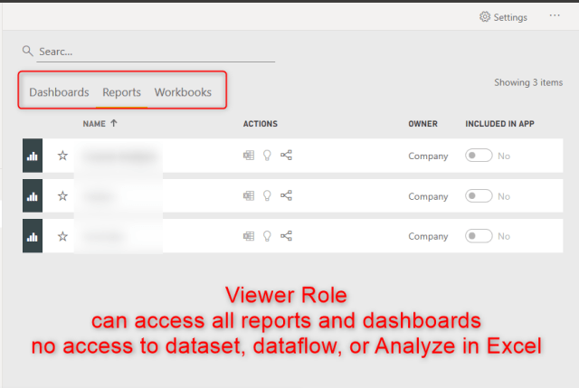
1. Viewer Role – Part 2

Slide 16
2. Contributor Role – Part 1
This role can access and interact with reports and dashboards.
Additionally, this role can create, edit, copy, and delete items in a workspace, publish reports, schedule refreshes, and modify gateways.
A Developer can get Contributor Role.

Slide 17
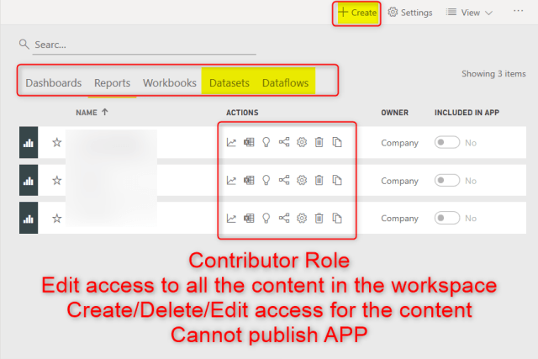
2. Contributor Role – Part 2

Slide 18
3. Member Role – Part 1
This role can access and interact with reports and dashboards.
Additionally, this role can create, edit, copy, and delete items in a workspace, publish reports, schedule refreshes, and modify gateways.
Special privileges to Member roles are :
This role is also able to add other users to the viewer or contributor role.
Members of this role can also feature dashboards on the service, share items, allow others to reshare items, publish or republish
A Developer can get Member Role.

Slide 19
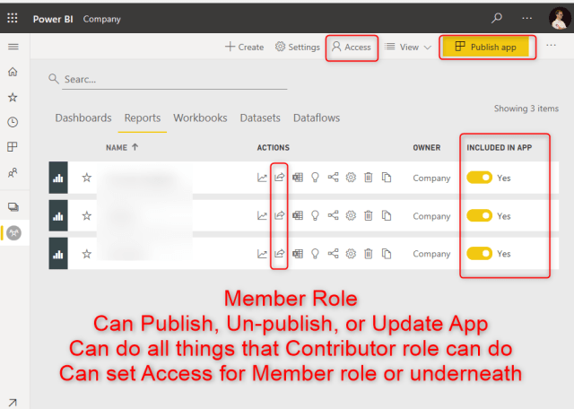
3. Member Role – Part 2

Slide 20
4. Admin Role
This role can do all the functions mentioned for Member role.
Plus add and remove all users including other Admins.

